Slide 1

Cloud Service 100% 활용
김영욱 Technical Evangelist
부장/ DX / Microsoft
youngwook@outlook.com
Blog: Youngwook.com
Notes:
안녕하세요 테크니컬 에반젤리스트 김영욱입니다.
평소에는 윈도우와 전쟁사 이야기를 많이 하고 있지만 최근에는 사물 인터넷 이야기를 많이 하게됩니다.

Slide 2


Slide 3

https://github.com/KoreaEva

Slide 4

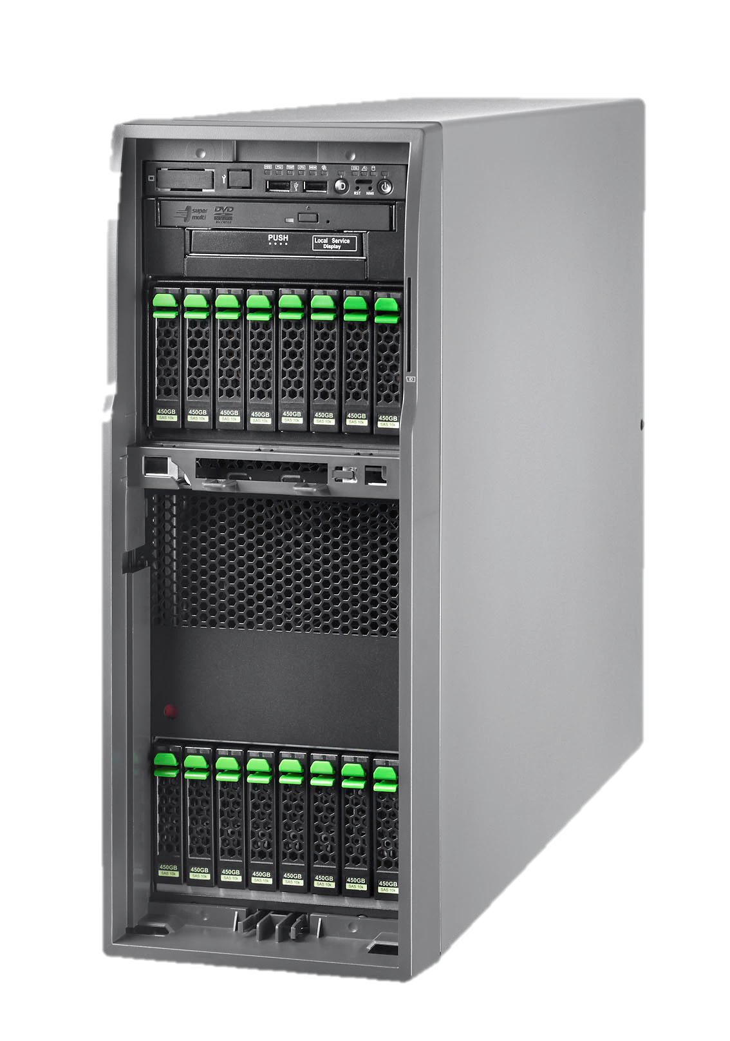
IU

Slide 5
Cloud는 역시? ( )
아마존

Slide 6
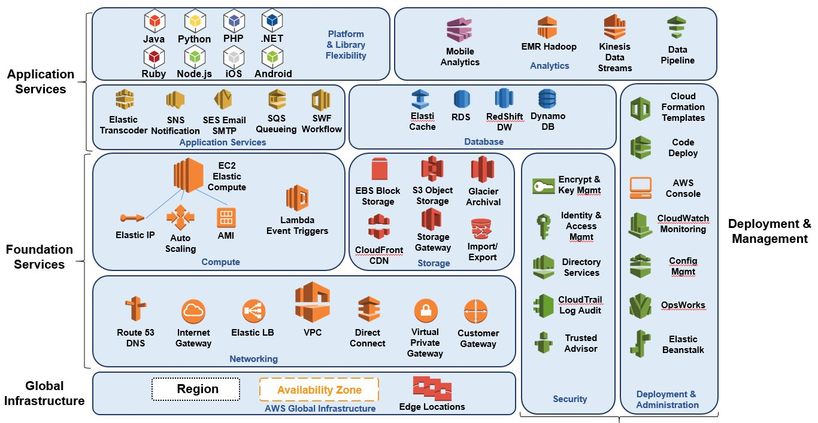

Slide 7

Storage
Compute
Data Analysis
Management
Network
Application
Service

Slide 8
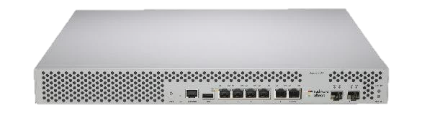


Network
Application
Service
Compute
Management
Storage
Data Analysis

Slide 9
Cloud는 역시? ( )
Mirosoft

Slide 10
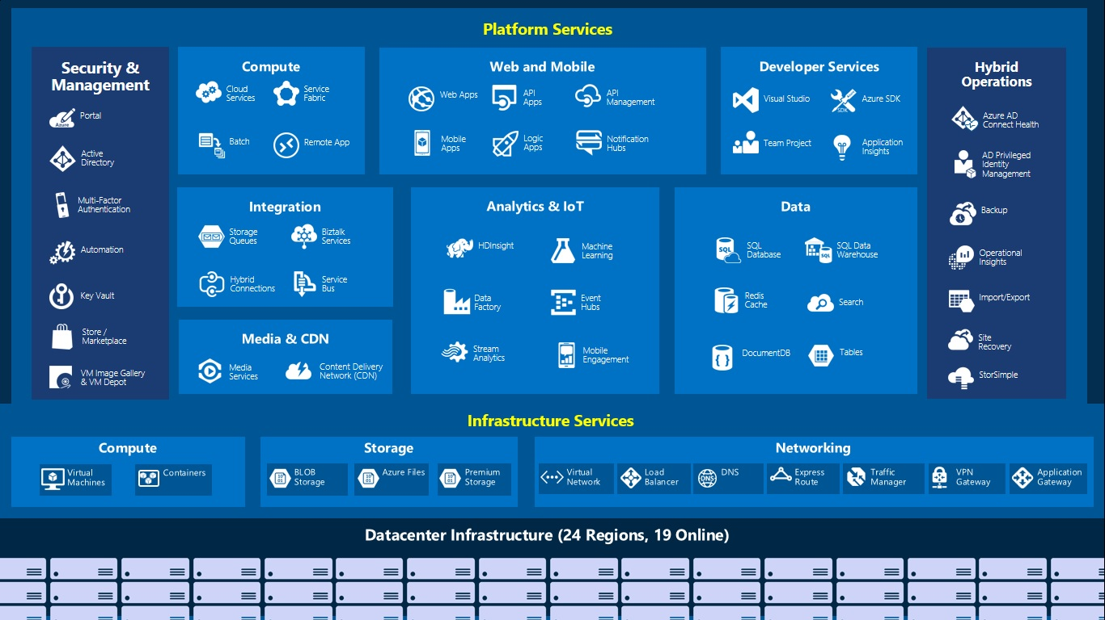

Slide 11

Compute
Developer Service
Network
IoT
Data Analysis
Storage
Security
Web & Mobile
Management

Slide 12
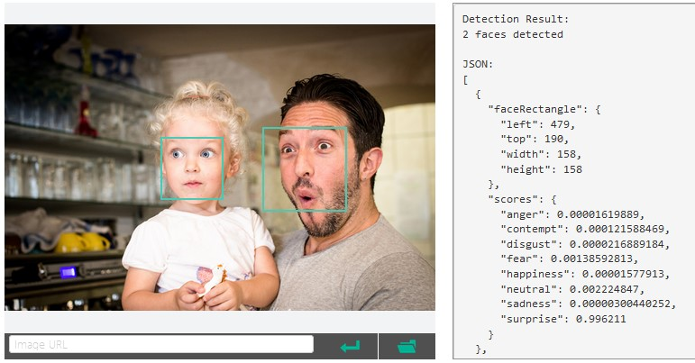
Cognitive

Slide 13

Cognitive Services
Vision
From faces to feelings, allow your apps to understand images and video
Microsoft Cognitive Services
Give your apps a human side
Speech
Hear and speak to your users by filtering noise, identifying speakers, and understanding intent
Language
Process text and learn how to recognize what users want
Knowledge
Tap into rich knowledge amassed from the web, academia, or your own data
Search
Access billions of web pages, images, videos, and news with the power of Bing APIs

Slide 14
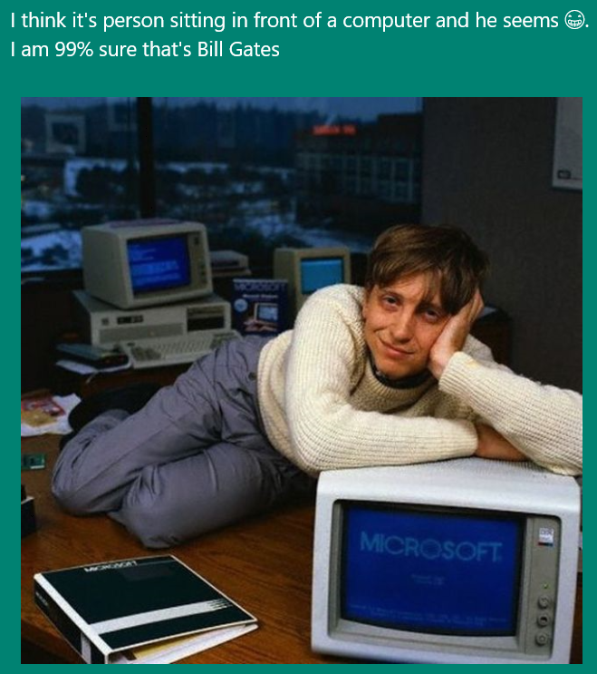
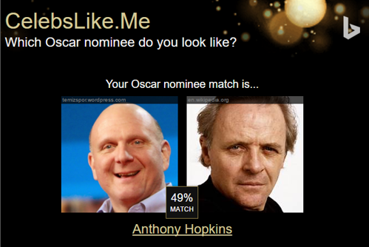

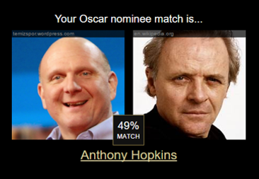
Apps Powered by MS Cognitive Services
I think it’s a person sitting in front of a computer and he seems ☺. I am 99% sure that’s Bill Gates
CaptionBot.ai
Celebslike.me
ProjectMurphy.net

Slide 15







Why Microsoft Cognitive Services ?
Easy
Flexible
Tested
Roll your own with REST APIs
Simple to add: just a few lines of code required
Make the same API code call on iOS, Android, and Windows
Integrate into the language and platform of your choice
Built by experts in their field from Microsoft Research, Bing, and Azure Machine Learning
Quality documentation, sample code, and community support
GET A KEY
BUILD

Slide 16

Cognitive Services
microsoft.com/cognitive
Vision
Speech
Language
Knowledge
Search
Computer Vision
Custom Recognition
Bing Spell Check
Academic Knowledge
Bing
Web Search
Emotion
Speaker Recognition
Linguistic Analysis
Entity Linking
Bing
Image Search
Face
Speech
Language Understanding
Knowledge Exploration
Bing
Video Search
Video
Translator
Text Analytics
Recommendations
Bing
News Search
WebLM
Bing
Autosuggest

Slide 17
Cognitive Services
microsoft.com/cognitive
Vision
Speech
Language
Knowledge
Search
Computer Vision
Custom Recognition
Bing Spell Check
Academic Knowledge
Bing
Web Search
Emotion
Speaker Recognition
Linguistic Analysis
Entity Linking
Bing
Image Search
Face
Speech
Language Understanding
Knowledge Exploration
Bing
Video Search
Video
Translator
Text Analytics
Recommendations
Bing
News Search
WebLM
Bing
Autosuggest

Slide 18
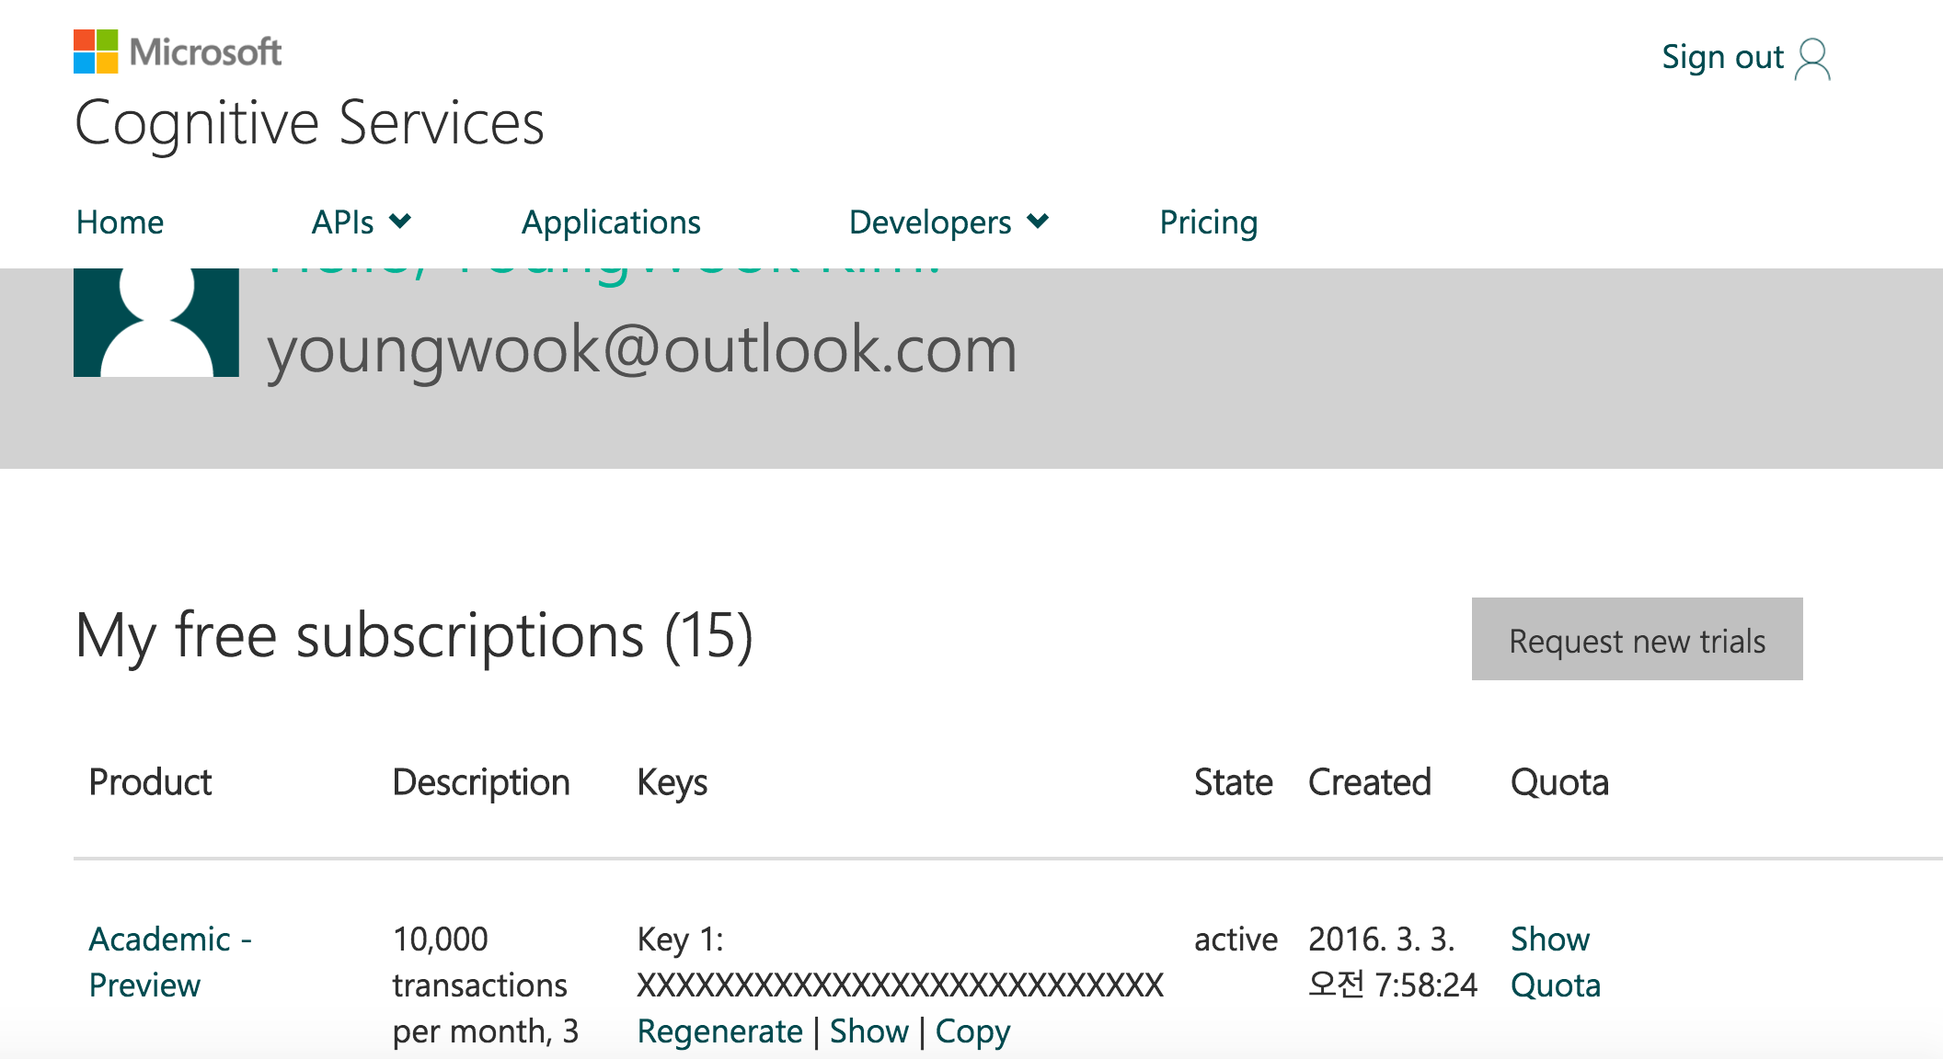
{Subscription Key}

Slide 19
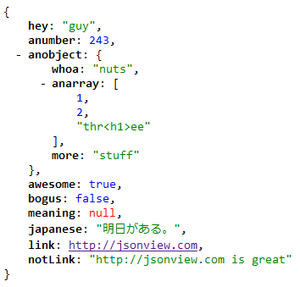

JSON
http://www.json.org/json-ko.html

Slide 20
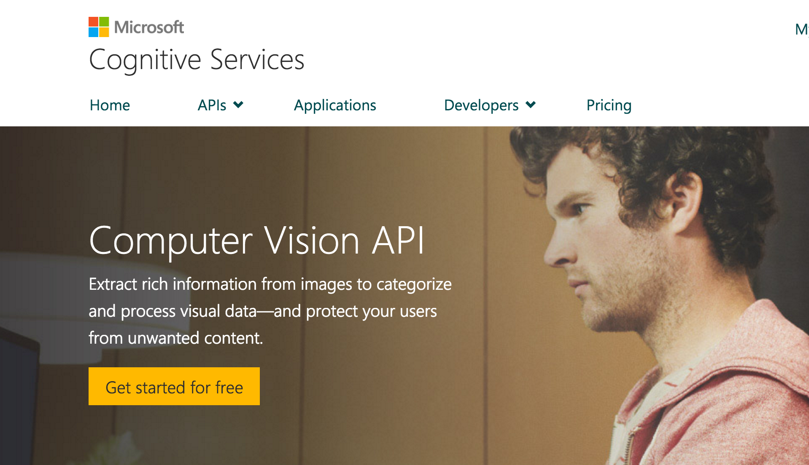

Slide 21
Demo

Slide 22
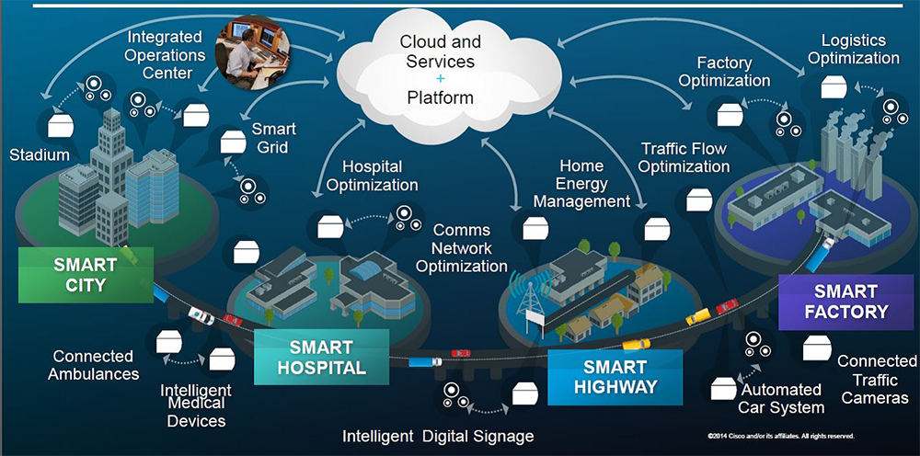
Internet of Things

Slide 23




Microsoft Data platform End-to-end 서비스
디바이스 및 센서
데이터 연결 및 처리
데이터 저장 및 성능
분석
프레젠테이션 및 활용

Slide 24











Microsoft IoT platform End-to-end 서비스
디바이스 및 센서
데이터 연결 및 처리
데이터 저장 및 성능
분석
프레젠테이션 및 활용
각종 소형 디 바이스 및 센서 | IoT 허브 (대량 Telemetry 수집) | SQL Database (PaaS 형태의 SQL Server 서비스) | 머신러닝 (고급 분석 및 기계학습) | Power BI (데이터 분석& 시각화 플랫폼)
대형 기계 장 치 및 그 센서 | Event Hub (대량 이벤트 수집) | Table/Blob 저장소 (클라우드 저장소) | 스트림 분석 (실시간 분석)
 | 서비스 버스 (메시지 연결) | DocumentDB (NoSQL 문서DB 서비스) | HDInsight (클라우드 상의 Hadoop 시스템)
 | 데이터카탈로그 (데이터 원본 검색) | 데이터 레이크 (빅데이터를 위한 저장소 및 분석) | Revoluton Analytics (고성능 R 통계분석)
 | Data Factory (클라우드 상의 ETL) | SQL DW (DW 특화 서비스)
 |  | Redis Cache (클라우드 앱을 위한 Redis cache)
Windows 10 IoT core
{ }

Slide 25
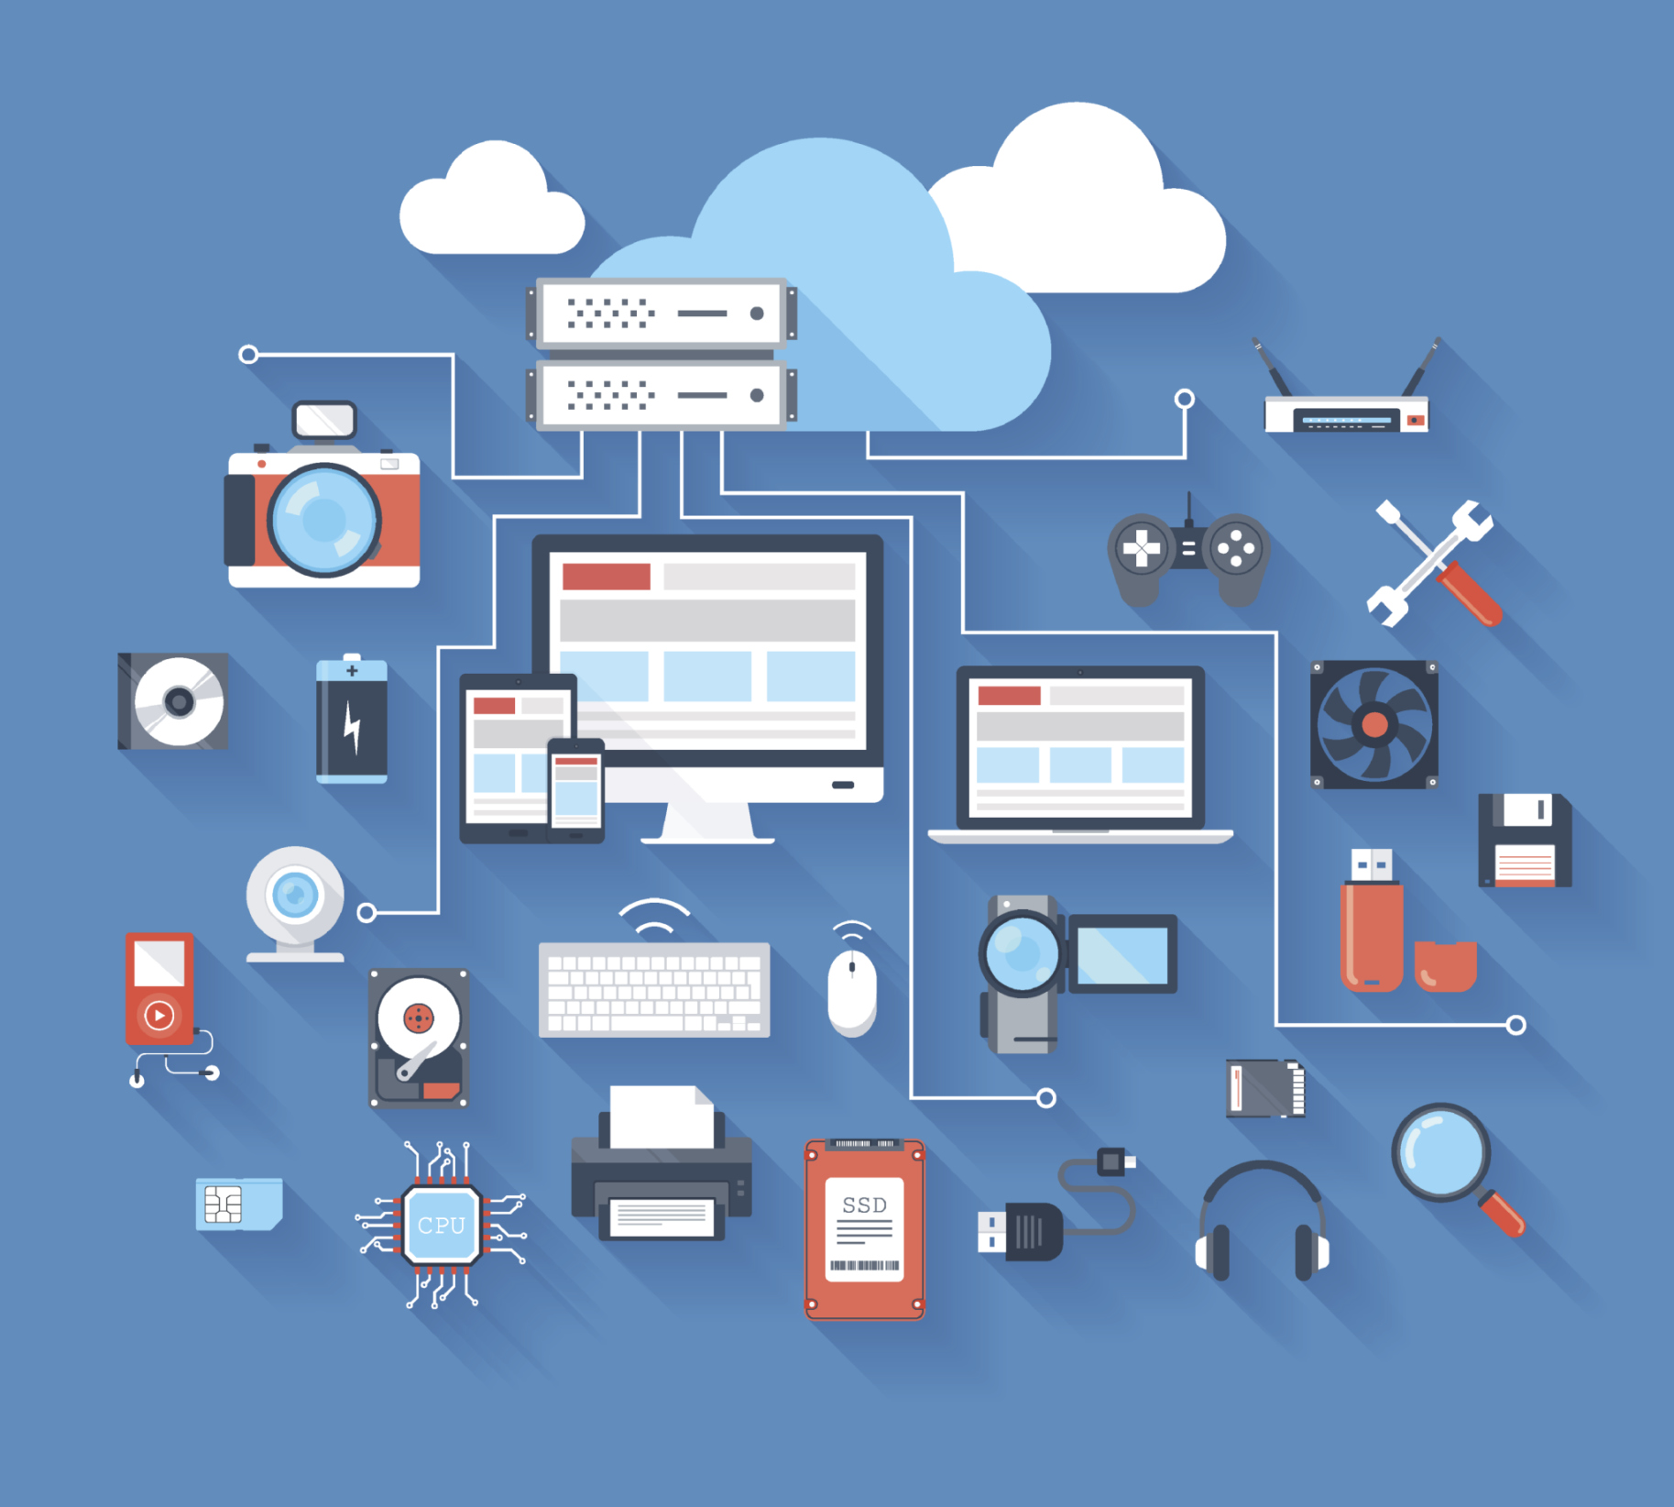
Services
IoT Hub
Stream Analytics

Slide 26



IoT 아키텍처
데이터의 흐름
통신 프로토콜
디바이스 및 센서
디바이스와 저장소 간의 연결
데이터 처리 및 저장
프레젠테이션 및 활용 영역
Batch processing :
Azure Data Factory, Azure HDInsight
Hot Path Analytics : Azure Stream Analytics, Azure HDInsight Storm
데이터 저장소 및 처리
프레젠테이션 또는
비즈니스에 연결
앱 서비스 배포, 웹 게시
CRM, ERP 등 사내 시스템과의 연동 및 알림 제공
MQTT, 웹 소켓 또는
사용자 프로토콜
사용자
게이트웨이 (클라우드
서비스, VM)
Device
Device
AMQP HTTPS, MQTT, OPC
Device
CoAP, AllJoyn, OPC
현장
게이트웨이
디바이스
Real-time Analysis
Data-At-Rest Analysis
Machine Learning (R)
고급 분석
AMQP HTTPS, MQTT, OPC
Device
IoT Hub
저상소 및 분석
Device
현장 게이트웨이
디바이스
사용자 게이트웨이
(클라우드
서비스, VM)
CoAP, AllJoyn, OPC
Device
VPN
LWM2M, HTTP, CoAP

Slide 27



DEMO
Cortana
Cognitive Services
SQL Database
Machine Learning
Stream Analytics
Power BI
Sensors on
Windows 10 IoT Core
IoT Hubs
Blob / Table
Notes:
Azure Event Hubs is a highly scalable publish-subscribe service optimized for reliably ingesting high volumes of data.
Event Hubs can process millions of events per second and stream them into multiple applications. This lets you analyze the massive amounts of data produced by your connected devices and applications. Once Event Hubs has collected the data, transform and store it by using any real-time analytics provider or with batching/storage adapters.
T: Cortana Intelligence take all of this data and stores it using Big Data storage technologies.
---
An application can benefit from Event hub when you have a large amount of data coming in, and at the same time, you need to process that large amount of data without risking any loss.
For example, you have a voice dictation application, and you collect the audio, and use a service bus to send it to windows, but have a lot of users. You would be better off using event hub and processing that data through stream analytics to sort the data, and from there route into whatever processing pipe you have set up. Because you need your user input and the feedback to be as quick as possible, while running analytics on the data, event hub will allow you to scale at the pace needed.

Slide 28
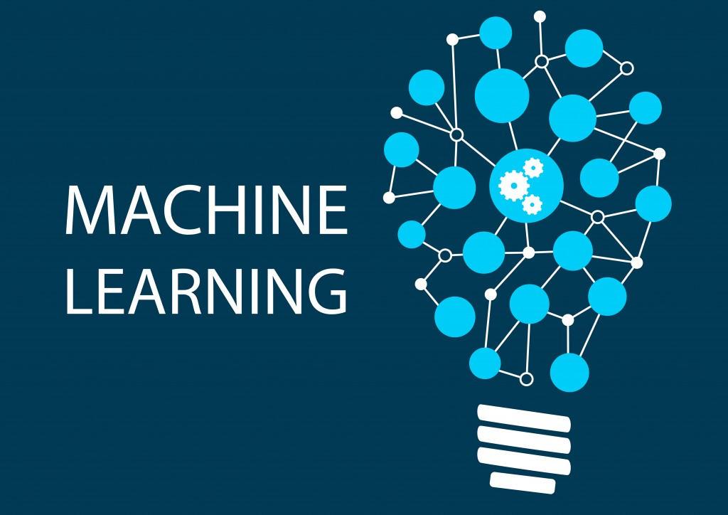
Machine Learning

Slide 29


Slide 30

Microsoft & Machine Learning 15 years of realizing innovation
1999
2004
2005
2008
2010
2012
2014
Computers work on users behalf, filtering junk email
Microsoft search engine built with machine learning
SQL Server enables data mining
Bing Maps ships with ML traffic-prediction service
Microsoft Kinect can watch users gestures
Successful, real-time, speech-to-speech translation
Microsoft launches Azure Machine Learning
Machine learning is pervasive throughout Microsoft products.
“
John Platt, Distinguished scientist at Microsoft Research
”

Slide 31

One solution for Machine Learning - from data to results
Web Apps
Mobile Apps
PowerBI/Dashboards
ML API service
Developer
Azure Portal
ML Studio
Azure Portal & ML API service
HDInsight
Azure Storage
Azure Ops Team
Azure Ops Team
Data Scientist
Desktop Data

Slide 32
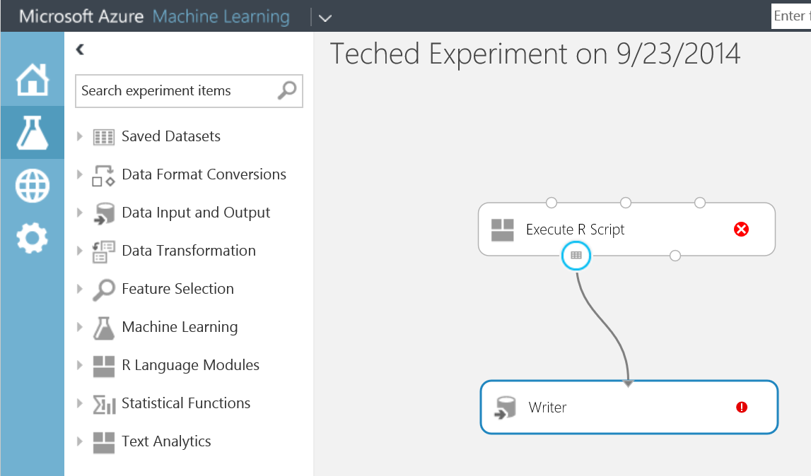
Machine Learning
Data I/O
Taking Data & preparing for Analysis
Dimensionality reduction. E.g. Kinect measures 1000 points, 6 are relevant
Fitting Model selection; calibration; assessment
R – free scripts/graphics, many packages based on Vector Data.
Metrics to allow us to describe the data. E.g. Mean, Correlation…
Tools used for Text Input. E.g. ‘What is the theme of this essay?’

Slide 33


